Slide 1
Jeans Equations
See Cappellari MNRAS 2008

Slide 2
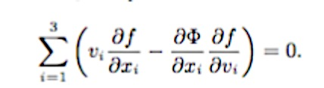
Collisionless Boltzman Eq
The positions x and velocities v of a large system of stars can be described by the distribution function (DF) f(x, v).
When the system is in a steady state under the gravitational influence of a smooth potential φ , the DF must satisfy the fundamental equation of stellar dynamics, the steady-state collisionless Boltzmann equation (Binney & Tremaine 1987, hereafter BT; equation [4-13b])

Slide 3
Collisionless Boltzman Eq
Since f is a function of six variables, an infinite family of solutions satisfies equation
Need additional assumptions and simplifications for a practical application of the equation.
classic way of constraining the problem consists of drastically reducing it, from that of recovering the DF, studying the the velocity moments of the DF.
This approach leads to the Jeans equations,

Slide 4

Jeans Equations
Assume axial symmetry, cylindrical coordinates (R,z,φ) and ∂φ/∂φ=∂f/∂φ=0
can re-cast the Boltzmann eq as
where v_{r},v_{z} and v_{φ} are velocities in the r,z and φ directions

Slide 5
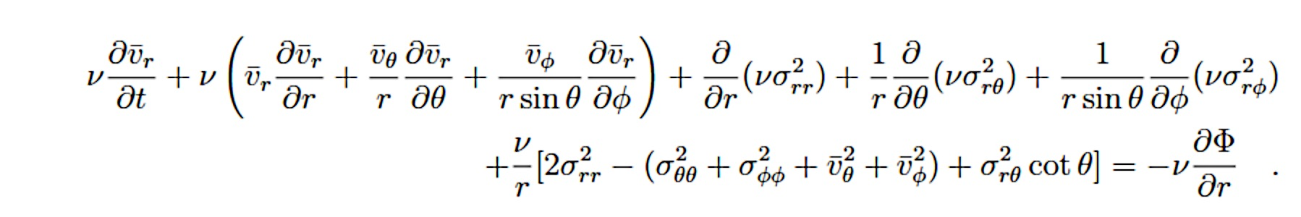
Jeans Equations
Then multiplying this equation by v_{φ} v_{r} and v_{z} and integrating over all velocities one obtains the Jeans eq (BT 4-29) where ν is the number density
Assuming steady state hydrodynamical equilibrium
(all time derivatives are zero) and spherical symmetry implies vθ = vφ = 0

Slide 6
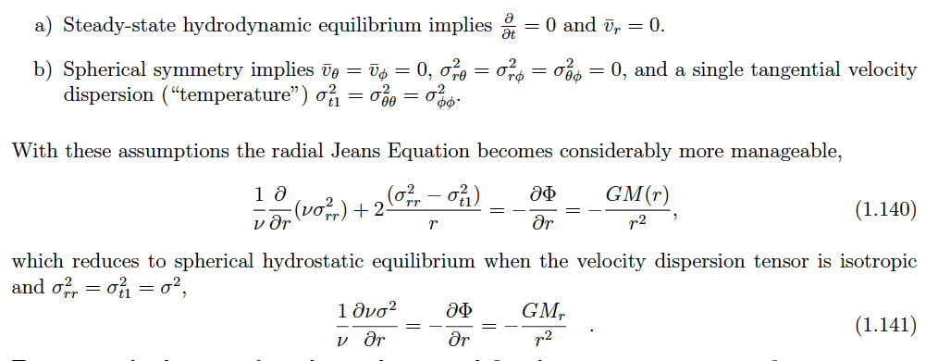
And you Get (MIT Course 8-902 notes)

Slide 7
Jeans Equations
However these equations are still a function of 4 unknowns and getting a unique solution is difficult
\

