Slide 1
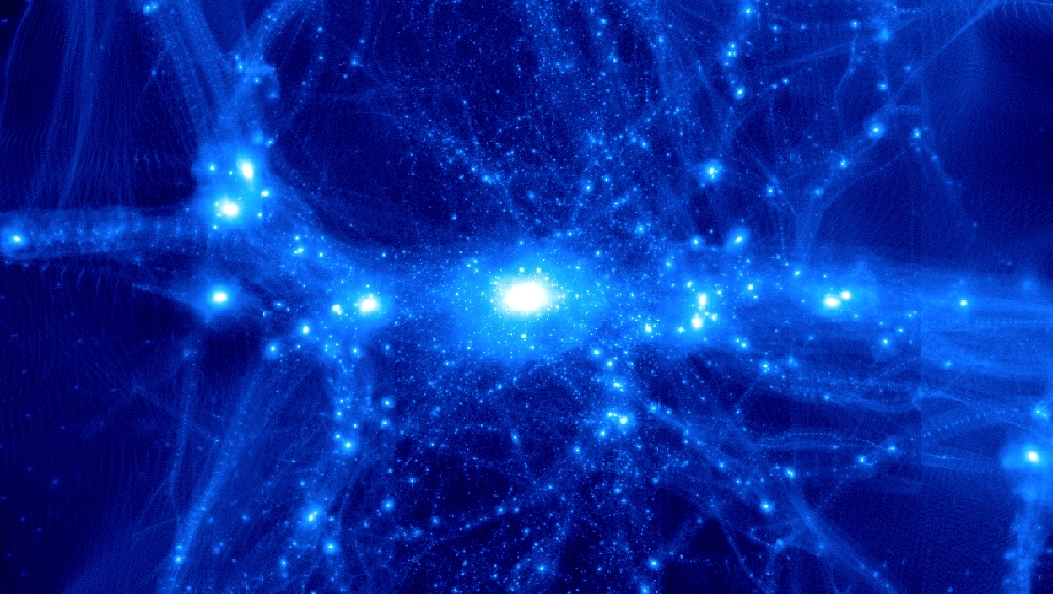
Theoretical Cosmology and Galaxy Formation at UMD
Massimo Ricotti
(associate professor)

Slide 2
Topics
Early universe – connection to Near Field
Galaxy formation in early universe
  Radiative/chemical feedback
  Near field Cosmology
  Dark matter simulations
Reionization of the intergalactic medium
  Ly-alpha forest
  Sources of reionization: role of GCs and X-rays
  Primordial BHs and CMB, etc

Slide 3
Current Students
Emil Polinsesky: simulations of the Milky Way in CDM and WDM
KwangHo Park: simulations of accretion onto IMBH with rad transfer
Kari Helgason: IR background fluctuations, in collaboration with Alexander Kashlinsky
Owen Parry (postdoc): simulations of first galaxies
Previous student: Mia Bovill (postdoc @ UT Austin)

Slide 4
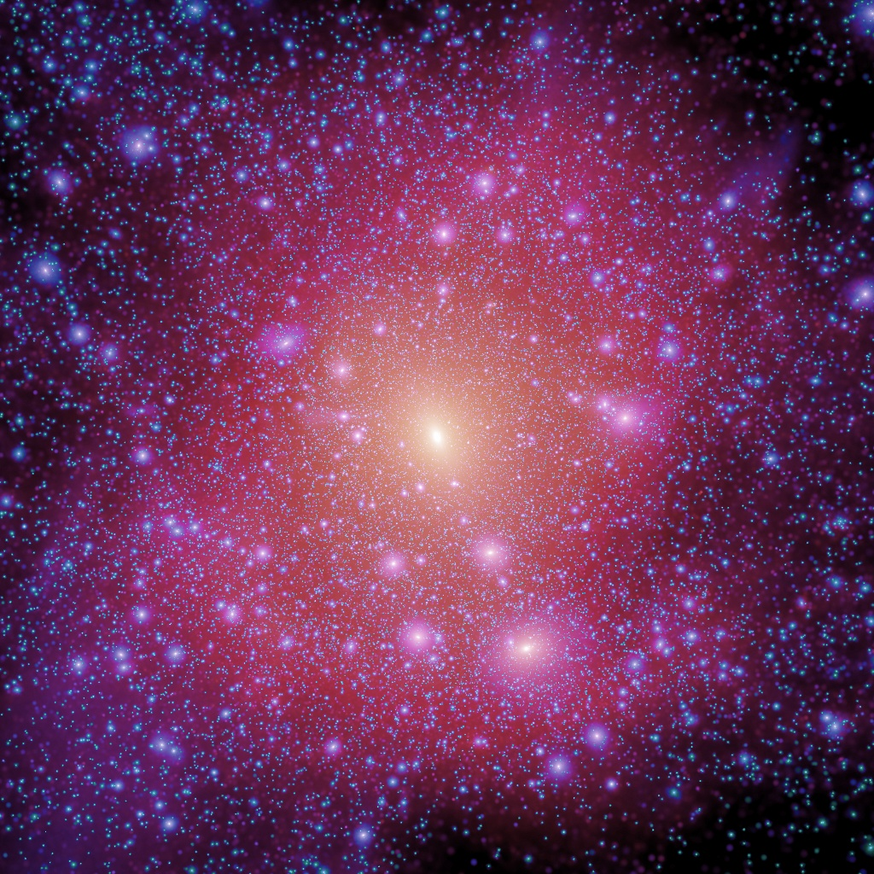
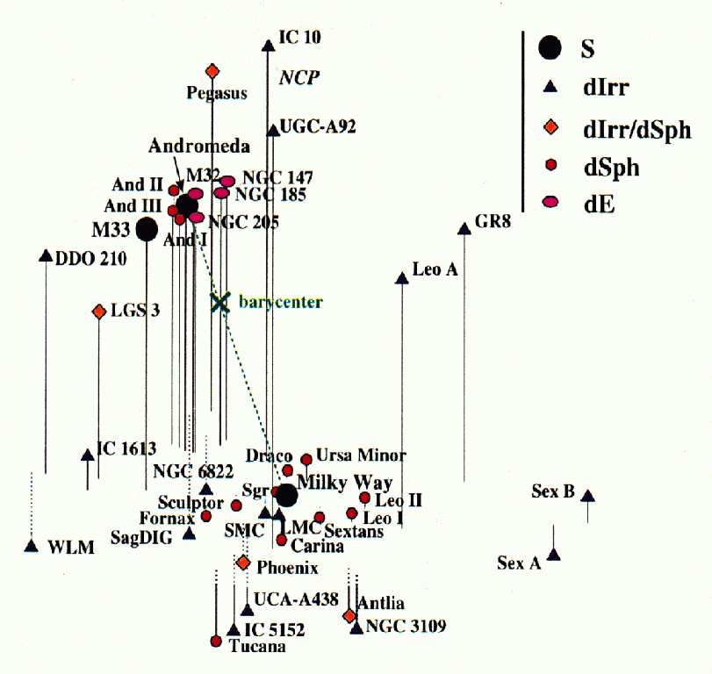
The Missing Satellites
Klypin et al 1999, More et al 1999
Figure credit: Grebel
There should be thousands of dwarf satellites around the Milky Way.
However, as of 2005 only about 30 satellites known in LG.
Aquarius Simulation (Springel et al, 2008)

Slide 5
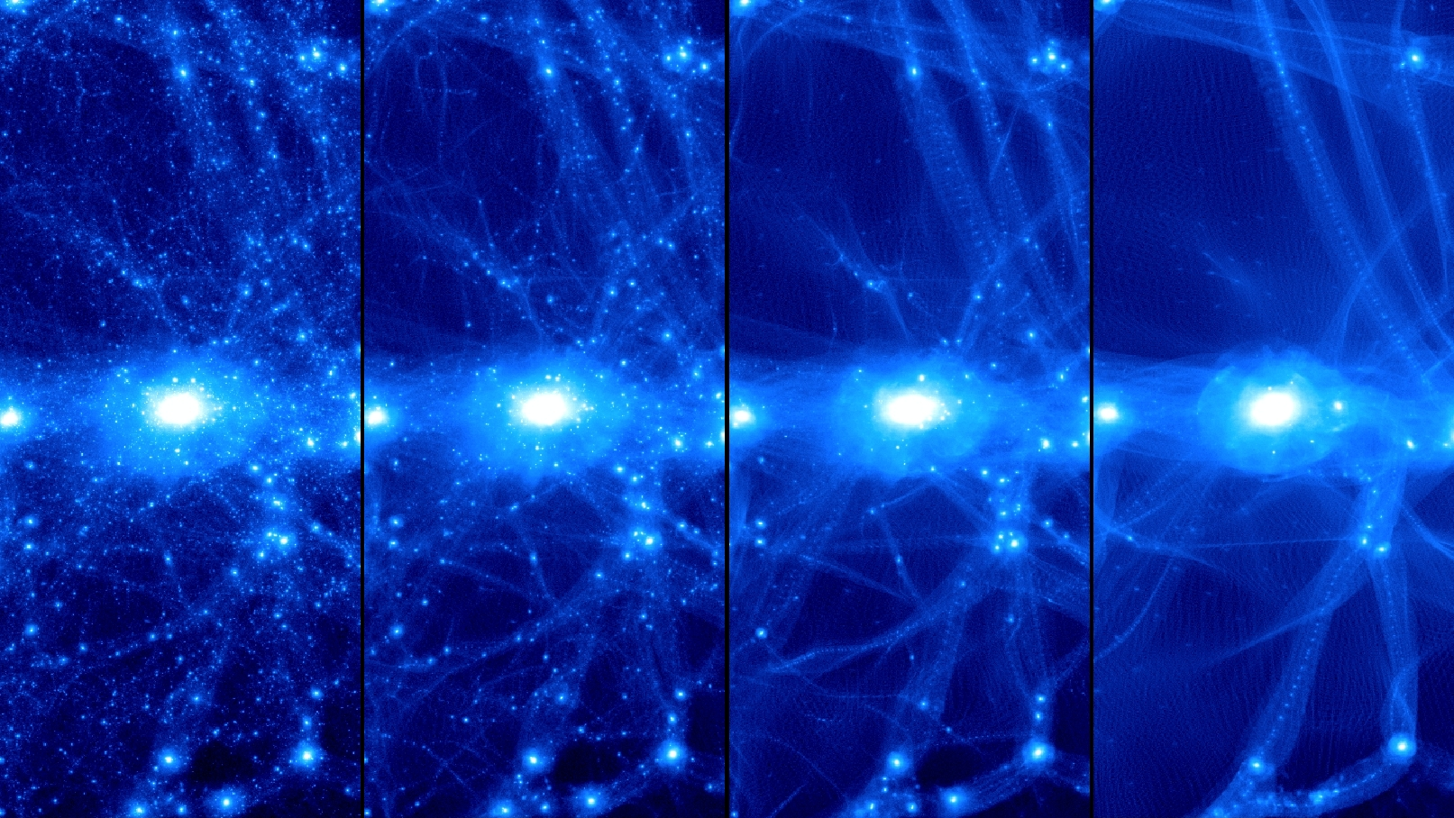
Warm Dark Matter
Cold
Warmer
Warmer yet
Warmest

Slide 6
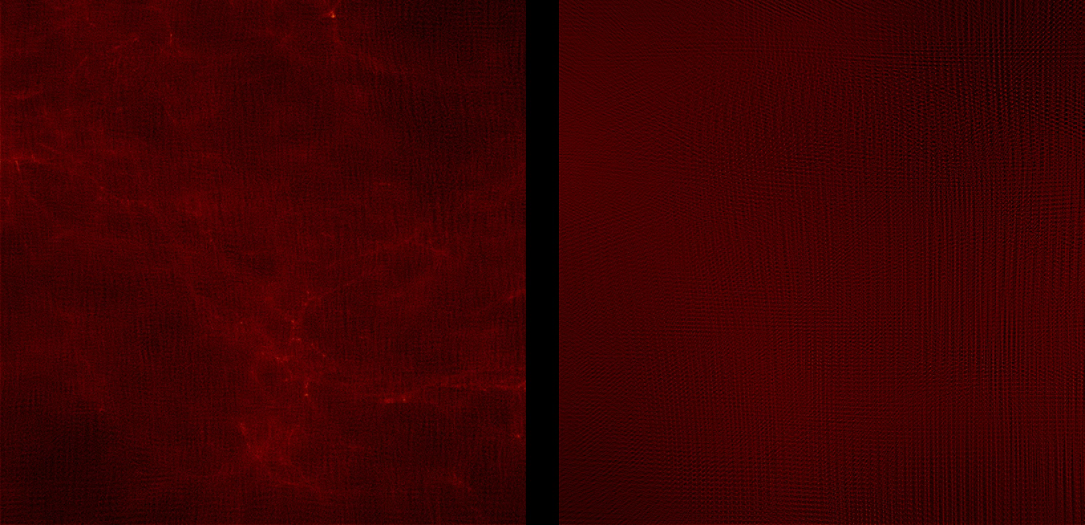

Slide 7
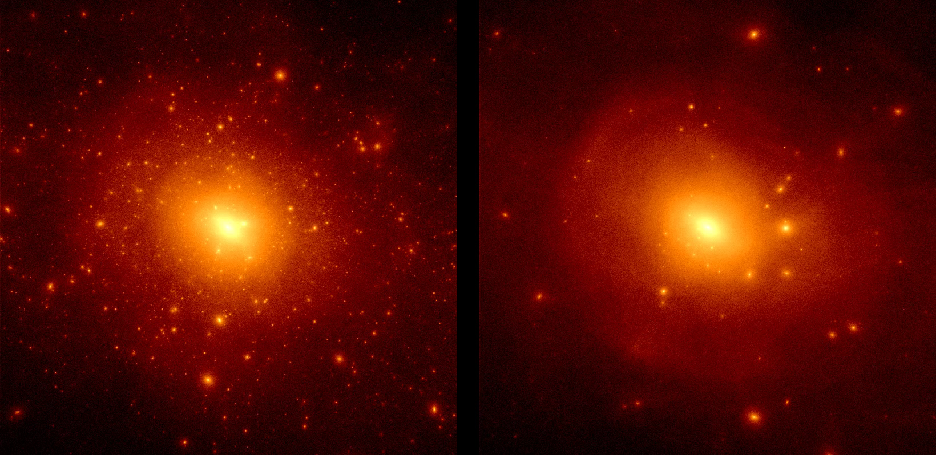

Slide 8
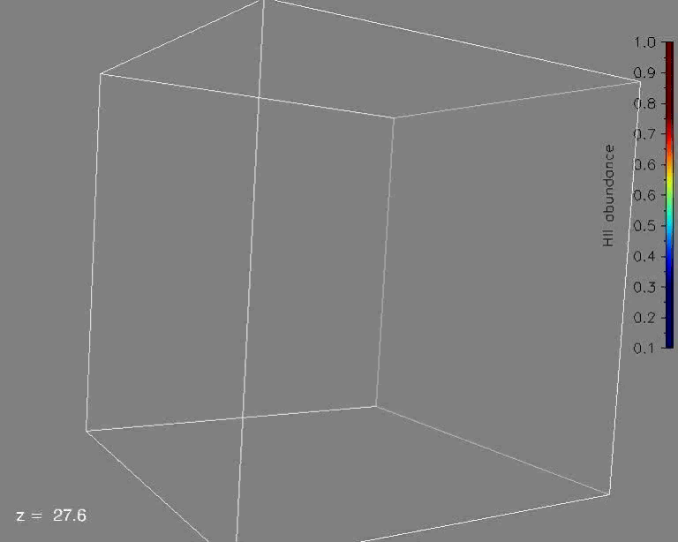
Simulations of the first galaxies
Feedback-regulated galaxy formation
1 Mpc box size
10³ M_{sun} mass res.
3D radiative transfer
Run ends at redshift of reionization
Ref: Ricotti, Gnedin & Shull 2002

Slide 9
Reionization feedback on dwarf galaxy formation
The reionization feedback idea is valid but fails at z<2 if the halo is highly concentrated
Minihalos virialized before reionization, that evolve to z=0 in the low-density IGM, have a late phase of gas accretion and possibly star formation
Do these objects exist?

Slide 10
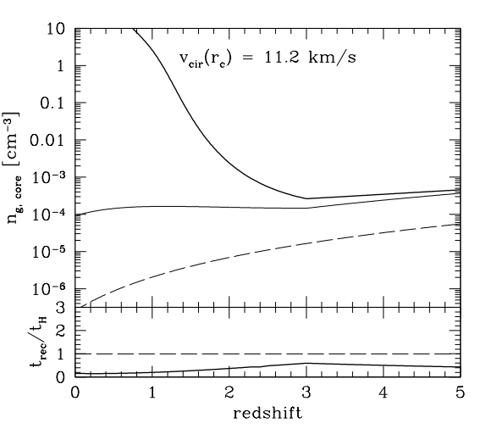
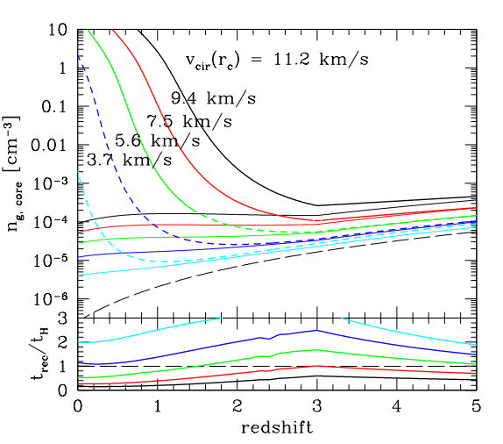
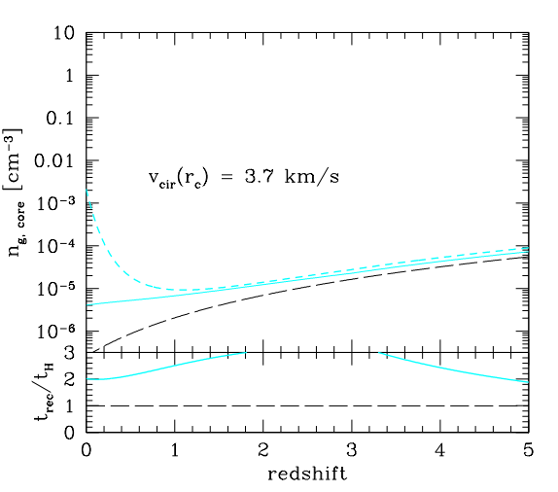
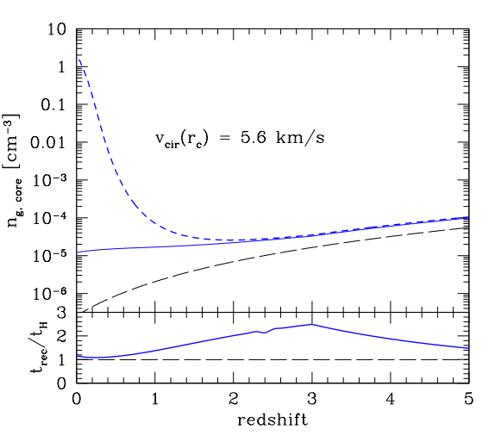
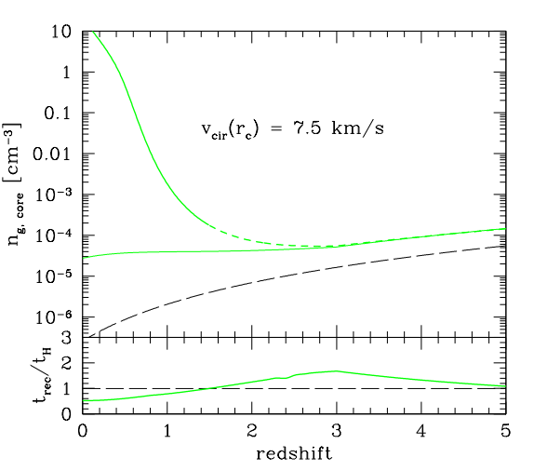
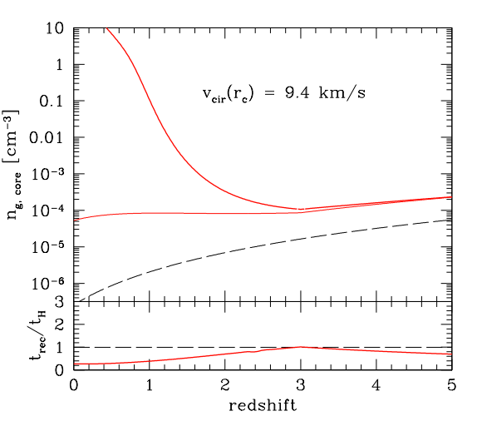
Late gas accretion onto mini-halos
Z_{vir}=10
Ref: Ricotti 2008

Slide 11
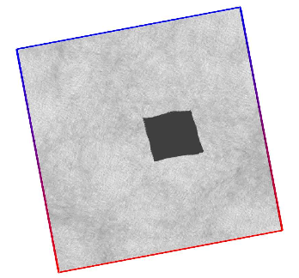
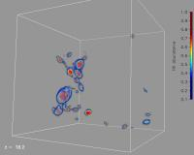
Hybrid Initial Conditions
The final pre-reionization output is transformed in a 1 Mpc³ box of particles.
We duplicate this box, adding perturbations to account for density variations with l > 1 Mpc.
Each HR particle in the resulting N-body simulation represents a pre-reionization halo.
Unique IDs allow us to retrieve the stellar properties at z = 0.

Slide 12
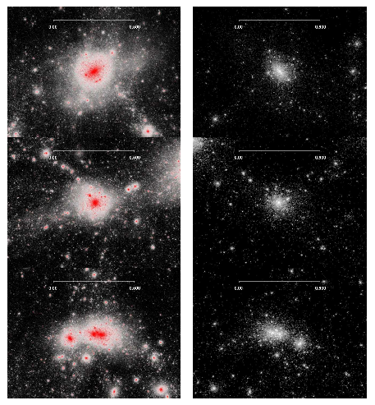

Slide 13
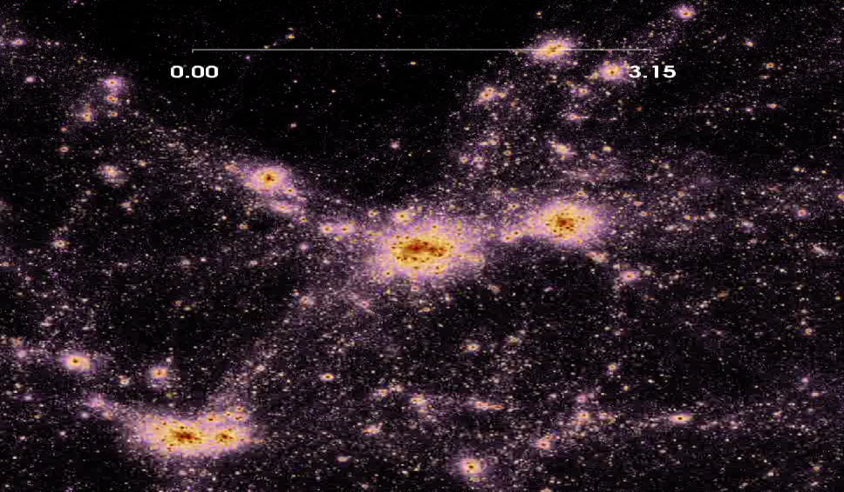

Slide 14
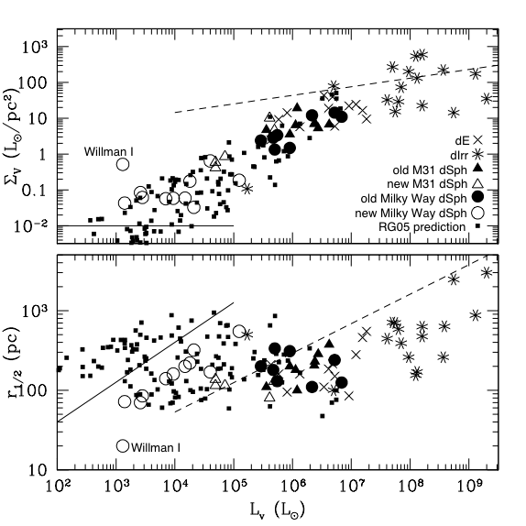
Pre-reionization fossils and ultra-faint dSphs: a model prediction!
Ref: Ricotti & Gnedin 05, Bovill & Ricotti 09

Slide 15
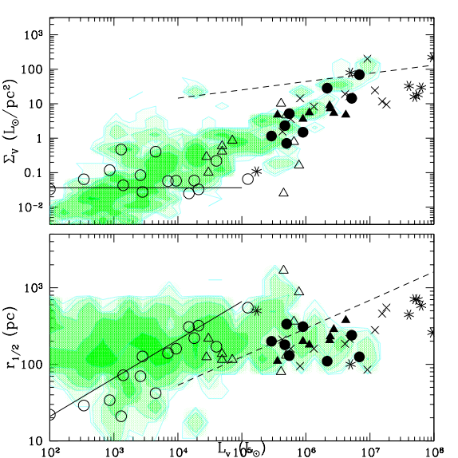
We now have z=0 halos which reproduce the faintest and smallest ultra-faints!
Yet undiscovered population

Slide 16
Sources of Reionization
Role of globular clusters (with Harley Katz, undergraduate)
Constraints from IR background fluctuations (Kari Helgason)
X-ray pre-ionization: redshifted X-ray background
  Accretion onto intermediate mass black holes with radiation feedback (KwangHo Park)
Primordial black holes

Slide 17
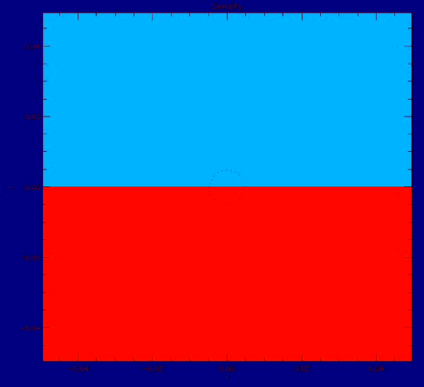
Bondi accretion with radiation feedback
Park & Ricotti 2011
100 M_{solar} IMBH
Gas density
Ionization fraction

Slide 18
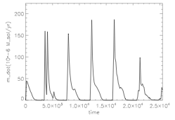
Accretion rate
Park & Ricotti 2011
See also Milosavljevic et al 2008

Slide 19
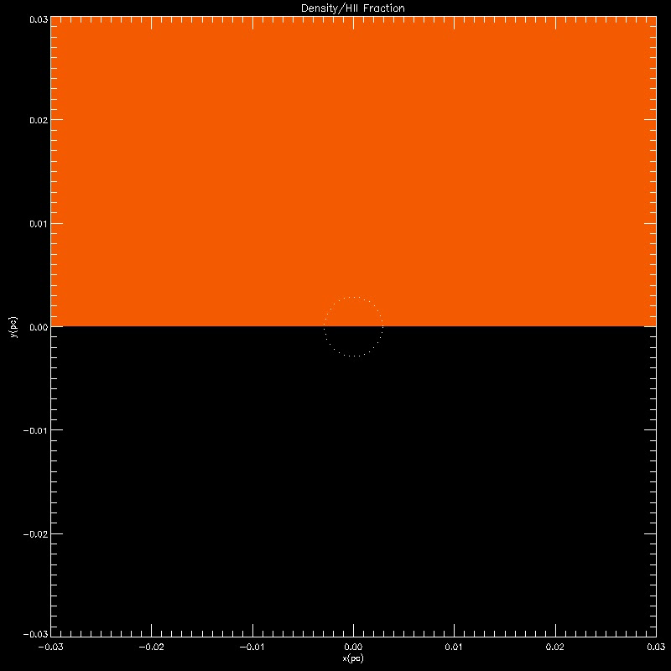

Two modes of accretion

Slide 20

Preliminary results
Moving BH + Radiative Feedback

Slide 21
Primordial black holes
PBHs modify recombination history and produce spectral distortions and anisotropies
New upper limits on f_{pbh} with WMAP3
PBHs promote formation of primordial H₂ and ﬁrst stars
Ultracompact minihalos as MACHOs

Slide 22
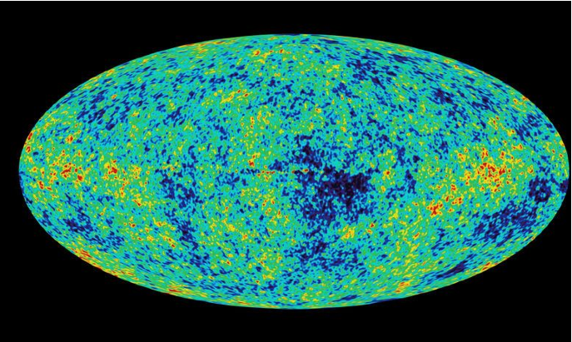
CMB anisotropies: WMAP3

Slide 23
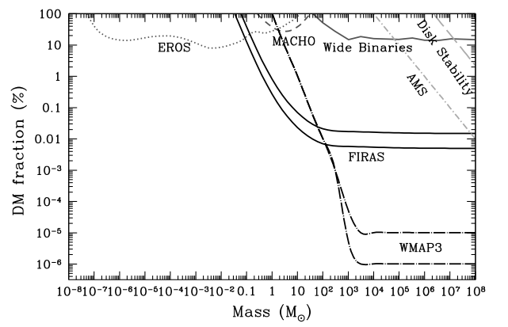
Constraints on f_{pbh} from WMAP 3

Slide 24
Backup slides

Slide 25
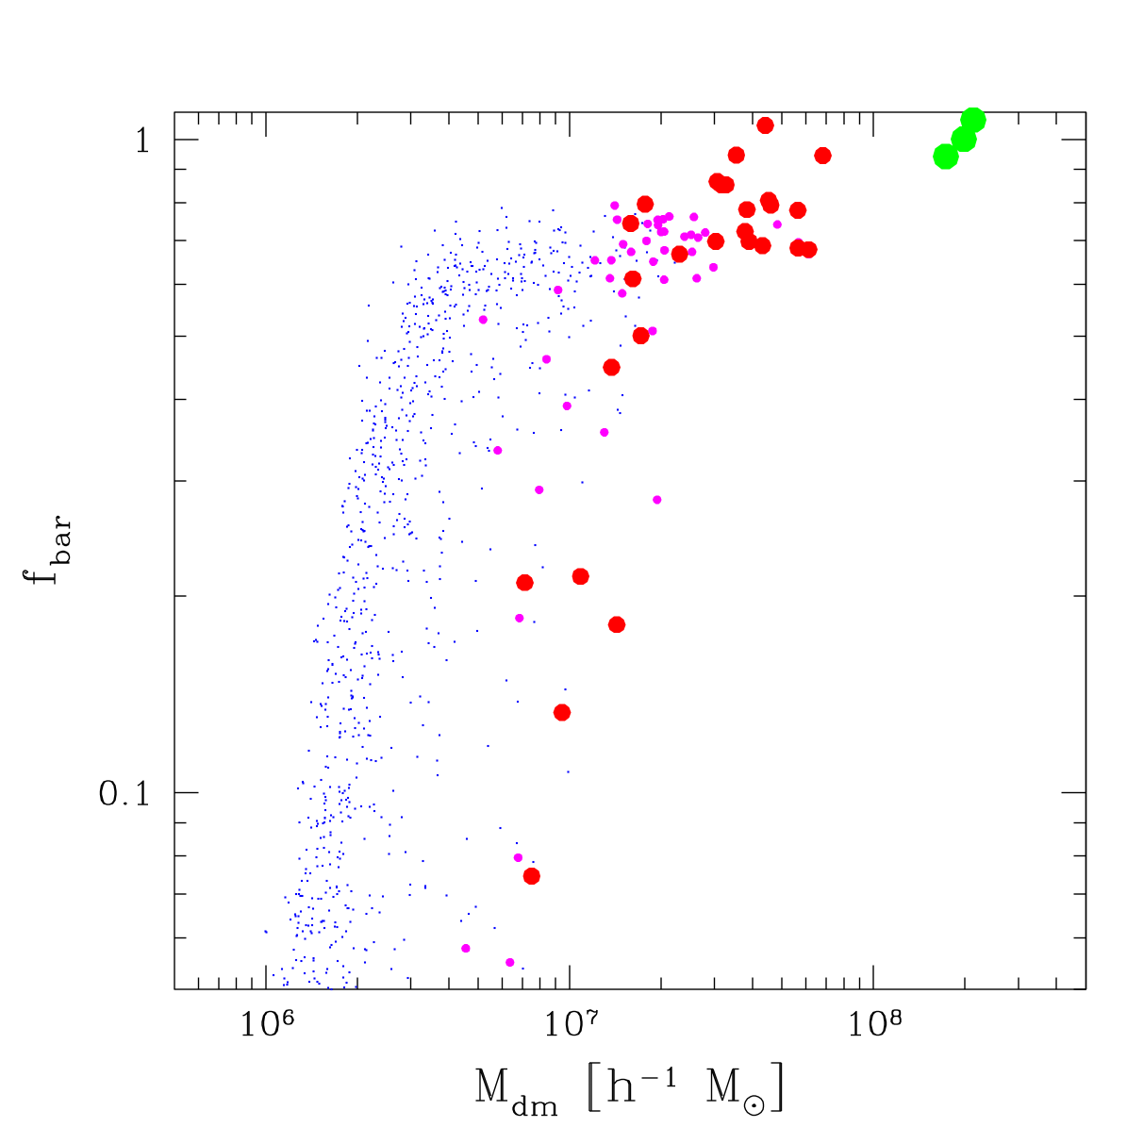
Properties of pre-reionization dwarfs
At z=10
Luminous galaxies
Pre-reionization
dwarfs
Fraction of cosmic baryons
Dark
galaxies

