Slide 1


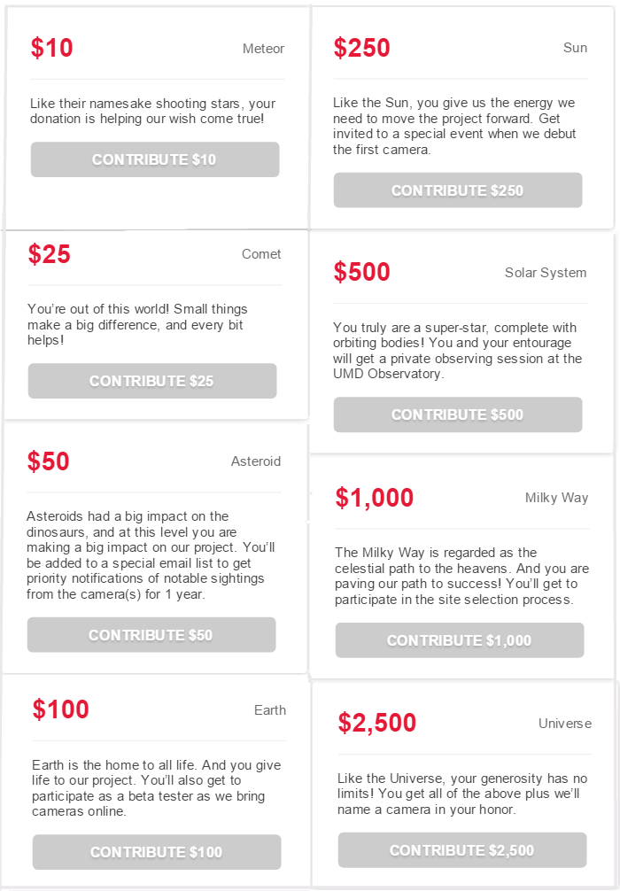
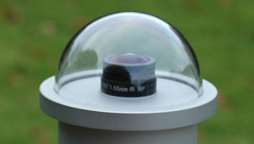
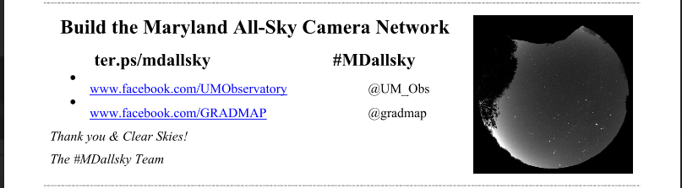
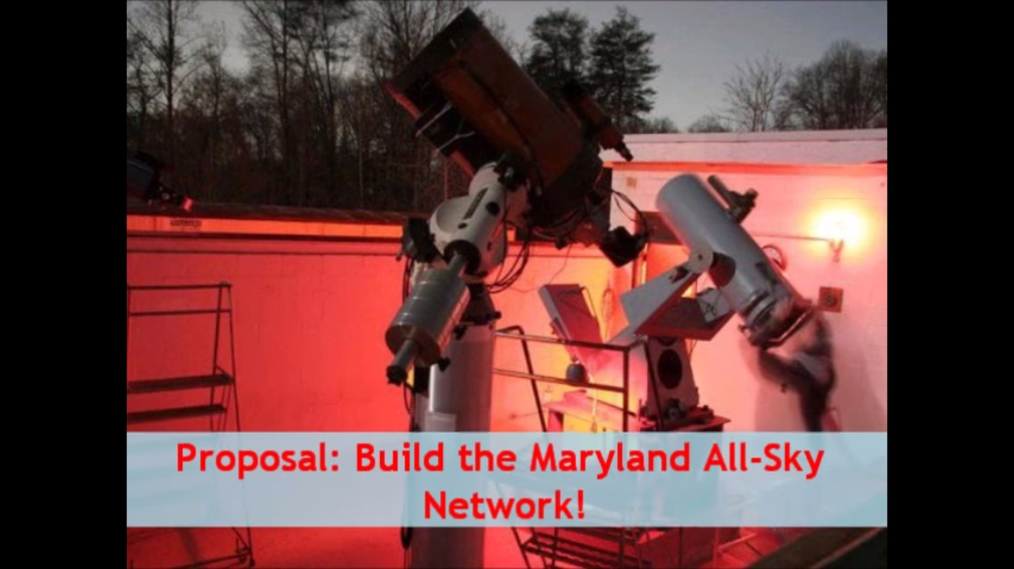
Building the Maryland All-Sky Network
Eric Lyness
elyness211@gmail.com
Science, Discovery, and the Universe
Computer Science
What is an all-sky camera?
An all-sky camera is a camera with a wide angle lens with a 180 degree field of vision that allows for large amounts of the sky to be monitored 24 hours a day.
What’s particularly unique to the all-sky camera is that it’s feed will be available to the general public.
Able to be useful to serious and professional astronomers but still interesting to amateurs and enthusiasts.
All-sky cameras are particularly useful in the observation of meteors (aka shooting stars) as having multiple cameras with an overlapping field of vision allows for useful data to be attained.
All-sky cameras require little maintenance and as long as the electronics with it are water-proof they are able to work unattended 24 hours a day, 7 days a week in an outdoor environment.
The images can be used to make time-lapse video allowing for the sky to be observed in real time
Project Results
Goal: $5000
Result: $8745
Worked with UMD Observatory and GRAD-MAP (Graduate Resources Advancing Diversity with Maryland Astronomy and Physics.
We ran this project with the help of Launch UMD, a school-run crowdfunding platform that allows for the Maryland community to get their projects going
Able to purchase 3 cameras and computer systems outright with the potential to get a 4th.
Will use computer systems to act as servers and for storage.
Cameras will be set up at UMD Observatory, Montgomery College, and one or two other undetermined locations.
Cameras are yet to be purchased, but once they have been, they will be available for public viewing online.
From Launch.umd.edu/mdsllsky
Flier distributed to garner support
http://www.sxccd.com/oculus-all-sky-camera
Image taken from video I helped produce
What I did
Assisted on many of the requirement Launch UMD had in order to properly exhibit our project.
Helped create a video used to promote the project
Assisted in the production and distribution of flier.
Drafted and revised emails to potential donors.
Created certificates of appreciation for each donor.
Generally assisted the project leader Elizabeth Warner.
Mentor information:
Elizabeth Warner
warnerem@astro.umd.edu
Photo credit: http://www.alcor-system.com/us/AllSkyCamera/TYTEA_cameras.html

