Slide 1


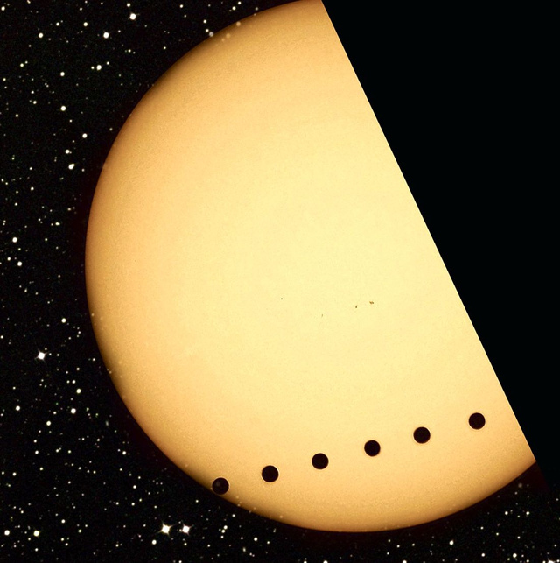
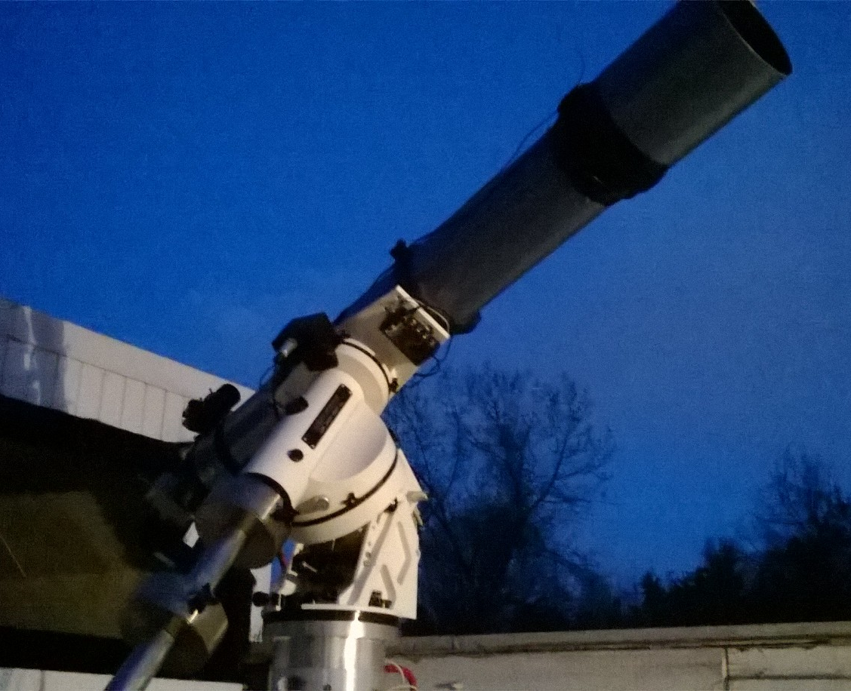
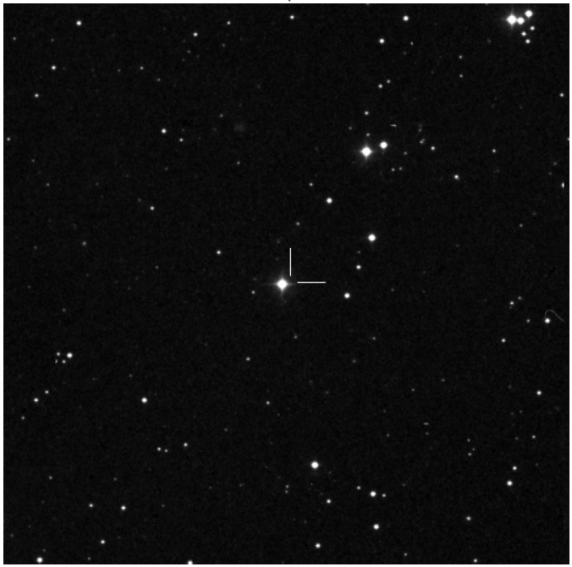
A Search For New Planets
Matthew Livas
mlivas@terpmail.umd.edu
Science, Discovery, and the Universe
Computer Science
Introduction
My capstone was to observe exoplanet transits. A transit is when a planet orbiting another star passes in front of its star from our view on Earth, blocking a small portion of the star’s light. This change in the target star’s brightness is detected by measuring the brightness of the star over time and subsequently graphing it to obtain a light curve.
My Data
Unfortunately, I did not collect any data pertaining to exoplanets. I signed up for telescope time at the UMD Observatory on a few nights to try and collect data on a few targets. Each time, the weather was bad (cloudy, raining, etc.), or the telescope was set up, and aimed but I was unable to confirm that I was observing the correct star.
Equipment
Telescope: 7” Astro-Physics Refractor
-Lens Dia: 7” (177.8 mm)
-Focal Length: 65” (1654 mm)
CCD: SBIG ST-10 XME
-Array Size: 2184 x 1472 pixels
-Array FoV: 32.0 x 21.5 arcmin
-Pixel Size: 6.8 x 6.8 microns
-Pixel FoV: 0.9 x 0.9 arcsec
Computer: Dell Desktop PC
Software:
-Camera Control: Maxim DL
-Analysis: AstroImageJ 3.0.1
Artist Rendition of a Transit
From https://wellbredinsolence.wordpress.com/2013/07/04/exoplanet-transits-and-star-shunters
Data’s Significance
I attempted to confirm the existence of a few already known exoplanets. This would have not added to the overall scientific knowledge, it would have been great practice for my true intention, to confirm suspected exoplanets. I unfortunately was unable to accomplish either of these goals.
Conclusion
I was unable to observe and collect data on exoplanet transits due to the weather and an inability to confirm if I was observing my intended target.
Data Collection
Pick a target
  Ensure visibility from the Observatory
  Obtain coordinates
  Obtain finder chart
Go to observatory (early)
Set up telescope
  Sync control computer’s time to NIST
  Hook up control computer to telescope
  Set cameras to cool (usually to -10 C)
Wait for the cameras to cool and darkness to fall
Aim the telescopes
  Sync telescope to a known star
  Set to cords of target
  Check images from telescope against
    finder chart
Take a ton of images
  Light Frames – Data
  Calibration Frames
    Dark Frames
    Bias Frames
    Flat Fields
7” Astro-Physics Refractor
Picture taken by Matthew Livas
Reflection
Through my work at the UMD Observatory, I gained a new appreciation of how difficult observational astronomy can be. There is a lot of research and planning done before any data is collected. So many factors must be taken into account: target visibility, telescope set-up and aiming time, is the weather going to cooperate, just to name a few. The real work begins only after the data is collected. Wrestling with the analysis software to produce usable information from the collected data and then relaying this information are the true challenges.
HAT-P-13 b from var2.astro.cz
Acknowledgements
The UMD Observatory
Ms. Elizabeth Warner
Dr. Alan Peel

