Slide 1
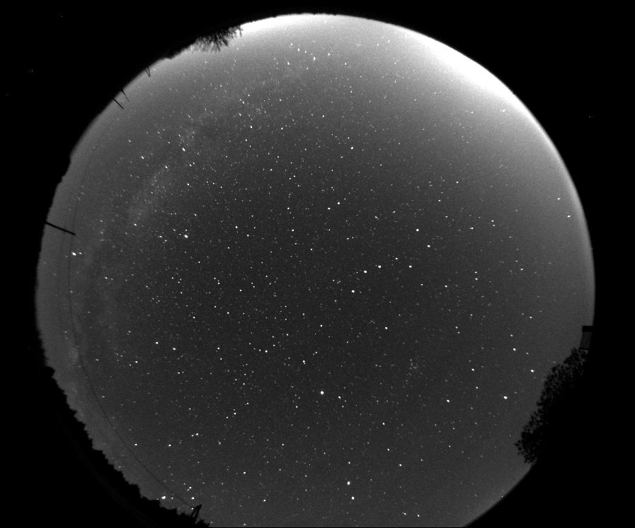


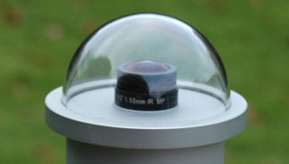
Building the Maryland All-Sky Network
Eric Lyness
elyness211@gmail.com
Science, Discovery, and the Universe
Computer Science
What is an all-sky camera?
An all-sky camera is a camera with a wide angle lens with a 180 degree field of vision that allows for large amounts of the sky to be monitored 24 hours a day. What’s particularly unique to the all-sky camera is that it’s feed will be available to the general public so the skies over Maryland can be observed and studied by serious astronomers and enthusiasts alike. All-sky cameras are particularly useful in the observation of meteors (aka shooting stars) as having multiple cameras with an overlapping field of vision allows for useful data to be attained.
Project Results
We ran this project with the help of Launch UMD, a school-run crowdfunding platform that allows for the Maryland community to get their projects going. The UMD Observatory and GRAD-MAP (Graduate Resources Advancing Diversity with Maryland Astronomy and Physics) used this platform to raise over 6000 dollars for camera systems, complete with capable computers to store and access the raw feed of the cameras as well as act as a server . This was enough for 2 complete systems, with a 3rd still within reach. The cameras will be placed at the UMD Observatory and Montgomery College Observatory.
What I did
My contributions to the project were mostly on the back end of it. I assisted on many of the requirement Launch UMD had in order to properly exhibit our project and assisted Elizabeth Warner in managing the project as it went on. Most of my time was spent drafting and reviewing text such as project descriptions and emails that would be sent out to prospective donors.
Mentor information:
Elizabeth Warner
warnerem@astro.umd.edu
Photo credit: http://www.alcor-system.com/us/AllSkyCamera/TYTEA_cameras.html

