Slide 1
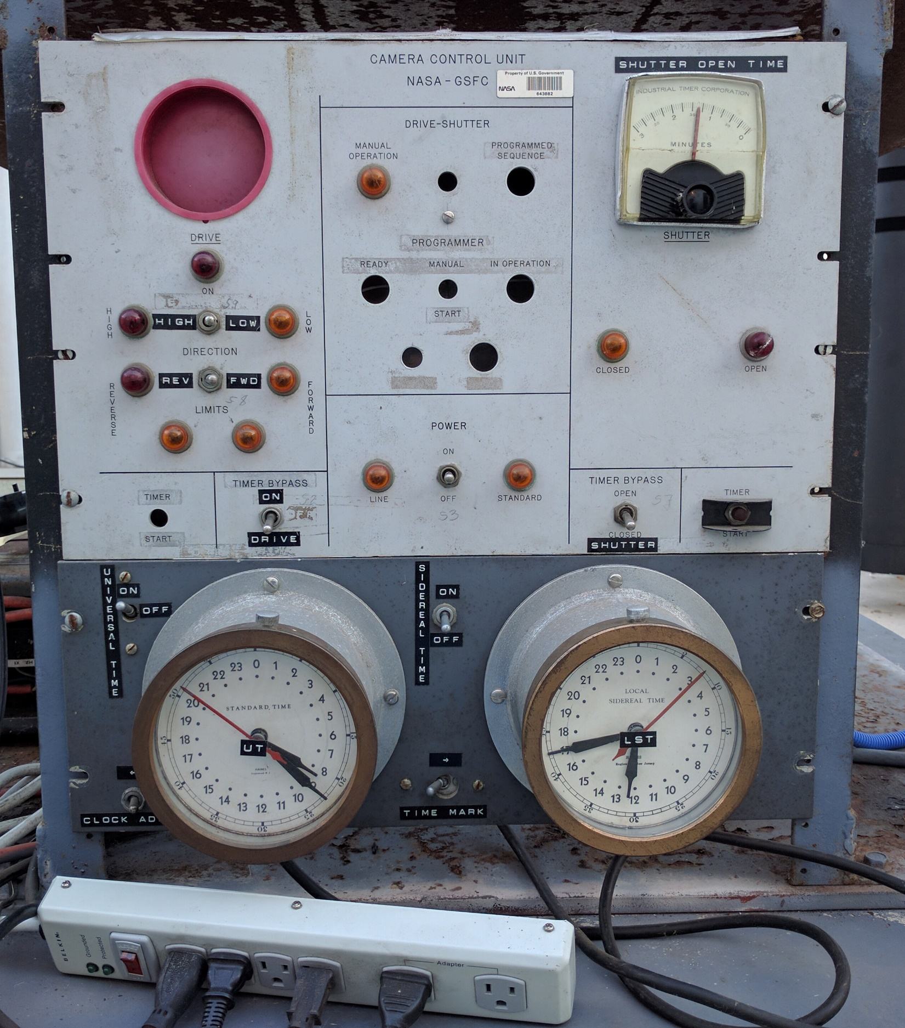
5
6
7
2
4
3
1
1. Power Strip (on/off)
2. Power toggle (on/off)
3. Shutter (open/close)
4. Drive/tracking (on/off)
5. Drive speed (high/low)
6. Drive direction (rev/fwd)
7. Limit lights

