Slide 1
2014 Observing
Highlights
Elizabeth Warner
UMD Observatory Coordinator

Slide 2
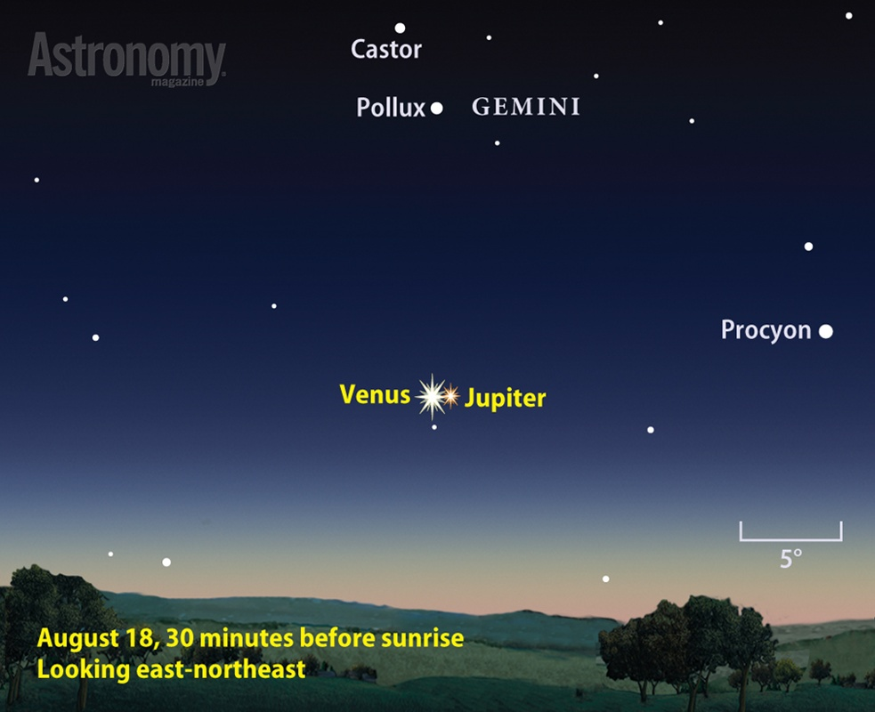
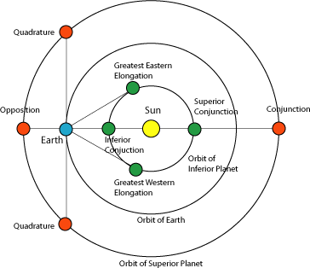
Planets at
Opposition
29 Aug – Neptune
7 Oct – Uranus
Conjunction
18 Aug - Venus and Jupiter
www.astronomy.com/observing/sky-events/2014/05/venus-and-jupiter-pair-up

Slide 3
Eclipses eclipse.gsfc.nasa.gov/OH/OH2014.html
15 Apr – Total Lunar (cloudy)
29 Apr – Annular Solar (not visible here)
9 Oct – Total Lunar
23 Oct – Partial Solar

Slide 4
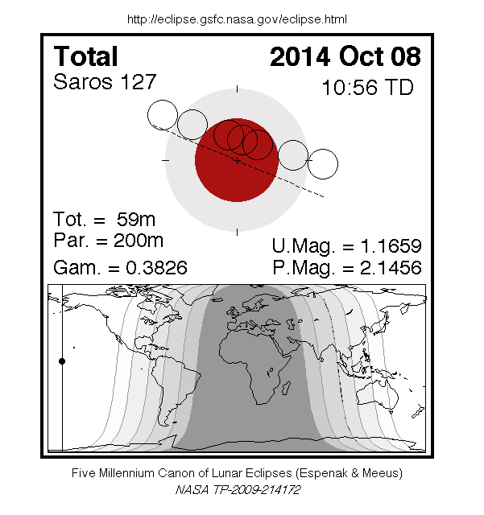

Slide 5
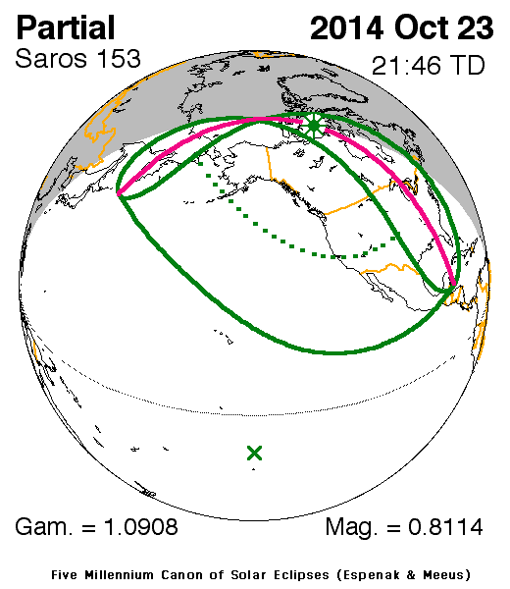

Slide 6
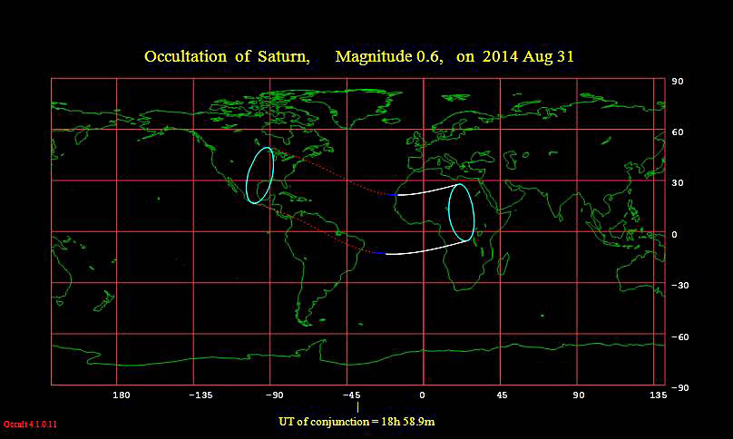
Occultations
20 Mar – Occultation of Regulus (cloudy)
26 Jun – Moon occults Mercury? (Just misses for us, happens at sunrise…)
31 Aug - The Moon occults Saturn for Africa and the eastern US (in the daytime) at ~18:59.

Slide 7
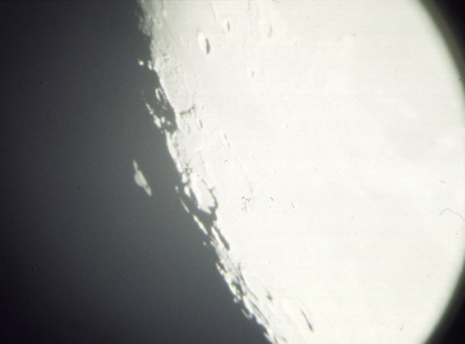
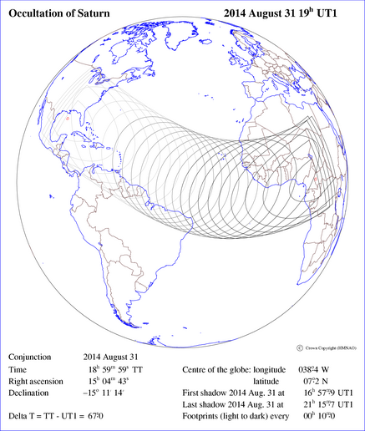
date: 11 November 1997
film: Fuji Provia
exposure: 1 sec.
camera setup: Minolta
telescope setup: 16" f/19 Cassegrain and 26mm eyepiece (Melton Mem. Obs.)
asa.usno.navy.mil/SecA/olist14.html

Slide 8
Meteor Showers
January 2, 3 - Quadrantids
April 22, 23 - Lyrids
May 5, 6 - Eta Aquarids
May 24 - Possible Meteor Storm (dud!)
July 28, 29 - Delta Aquarids
August 12, 13 - Perseids
October 8, 9 - Draconids
October 22, 23 - Orionids
November 5, 6 - Taurids
November 17, 18 - Leonids
December 22, 23 - Ursids
Major Meteor Showers in 2014
Shower | Radiant and direction | Morning of maximum | Best hourly rate | Parent
Quadrantid | Draco (NE) | Jan. 3 | 60-100 | 2003 EH₁
Lyrid* | Lyra (E) | Apr. 22 | 10-20 | Thatcher (1861 I)
Eta Aquarid | Aquarius (E) | May 6 | 20-60 | 1P/Halley
Camelopardalids | Camelopardalis (N) | May 24 | 100-1,000 | 209P/LINEAR
Delta Aquarid* | Aquarius (S) | July 29 | 20 | 96P/Machholz
Perseid* | Perseus (NE) | Aug. 13 | 60-80 | 109P/Swift-Tuttle
Orionid | Orion (SE) | Oct. 21 | 10-20 | 1P/Halley
Leonid* | Leo (E) | Nov. 17 | 10-20 | 55P/Tempel‑Tuttle
Geminid | Gemini (S) | Dec. 14 | 100 | 3200 Phaethon
* Moonlight will wash out fainter meteors in these showers.

Slide 9
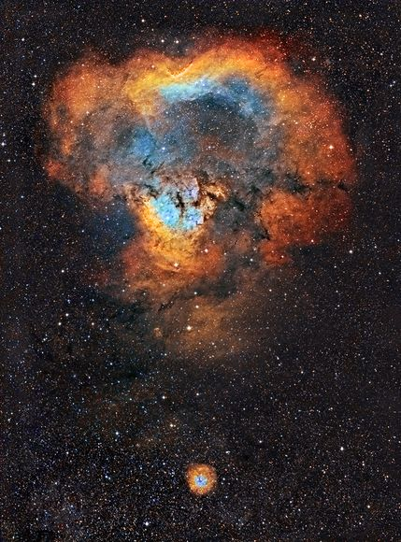
Comets www.aerith.net/comet/weekly/current.html cometchasing.skyhound.com/
19 Oct – Comet C/2013 A1 Siding Spring passes 7’ from Mars

Slide 10
Links
eclipse.gsfc.nasa.gov/eclipse.html
www.asteroidoccultation.com/IndexAll.htm
www.lunar-occultations.com/iota/iotandx.htm
asa.usno.navy.mil/
www.amsmeteors.org/2013/12/2014-meteor-shower-list/
www.aerith.net/comet/weekly/current.html
cometchasing.skyhound.com/

